Slide 1
LOW POWER TRANSMISSION USING LORA TECHNOLOGIES
Team Members:
B.PRASANTH(RA2211004050008)
E.G.PRADEEP(RA2211004050026)
Guided by,
DR.M.MATHAN KUMAR
Assistant Professor/ EEE
SEEE
SRMIST TRICHY

Slide 2
ABSTRACT
Along with the commercialization of the Internet of Things (IoT) technology, the demand for low-power and long-range, large amount of data transmission arises. However, there has been no such communication technology to satisfy the transmission. The Wi-Fi is able to send large amounts of data with its broadband technology, but because of high power consumption, it has to use firm power. The purpose of this study is to overcome those problems, design and suggest the multi interface communication module supporting LoRa technology
Key words: LoRa Technology, IoT, Long Range Communications, Energy Efficiency.

Slide 3
INTRODUCTION
Problem Statement: Interferences in Marine Communication.
Solution: Using LoRa Technologies instead of using Traditional Communication Systems.
Maritime communication has always been a challenge due to the vast and unpredictable sea environment.
Traditional systems: Expensive and consume a lot of power.
Closer to the shore, technologies are provide with some solutions, but they are not always energy-efficient, especially for small boats and battery-powered devices.
LoRa (Long Range) technology, a type of Low Power Wide Area Network (LP-WAN), offers long-distance communication
Ideal for tracking boats, monitoring ocean conditions, and enhancing safety operations.
In this study,We have introduced LoRa Technology instead of using Traditional Technologies to provide long distance Communications.

Slide 4


BLOCK DIAGRAM
0.96 12C OLED DISPLAY
DH11 SENSOR
Computer (to send Datas)
STM32 MICROCONTROLLER
STM32 MICROCONTROLLER
Computer (to receive Datas)
SENDER LR1278/SX1278
RECEIVER LR1278/SX1278

Slide 5
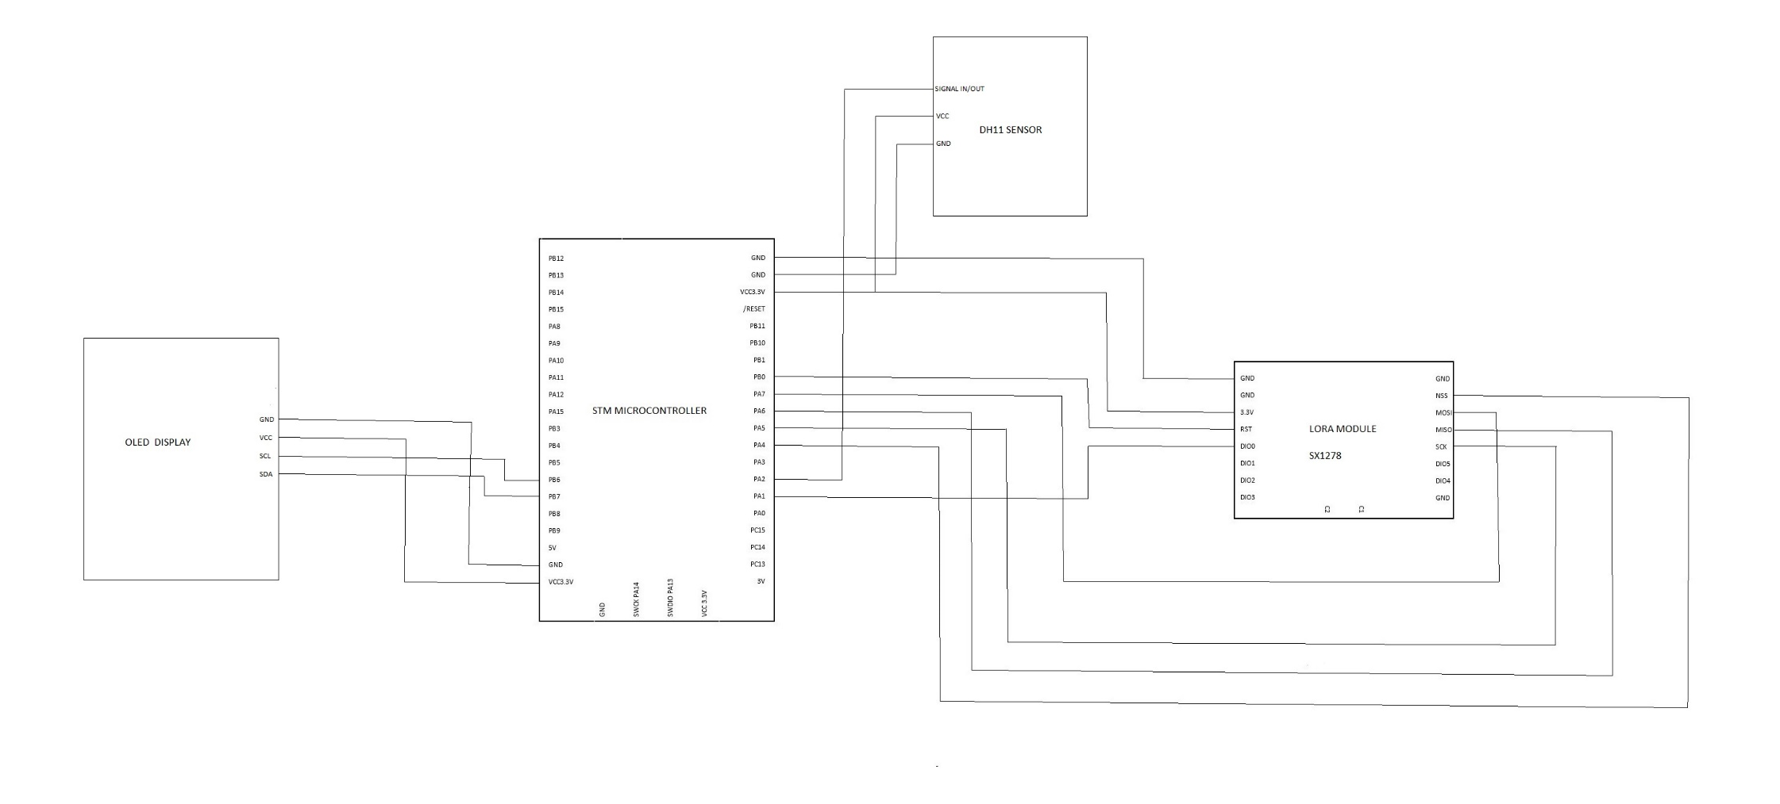
CIRCUIT DIAGRAM

Slide 6
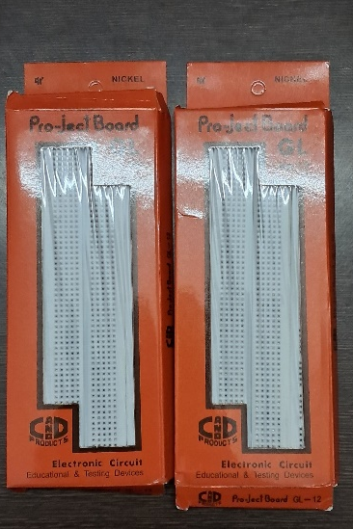
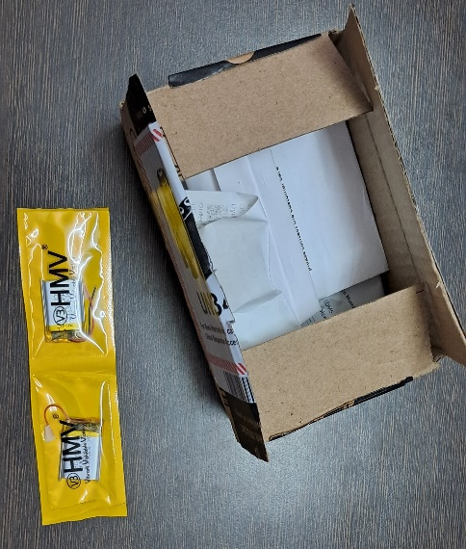
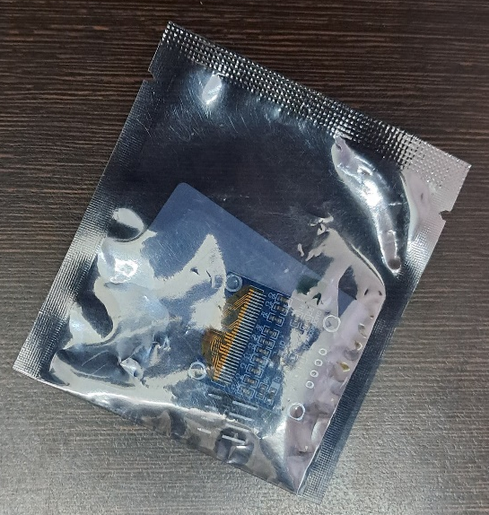
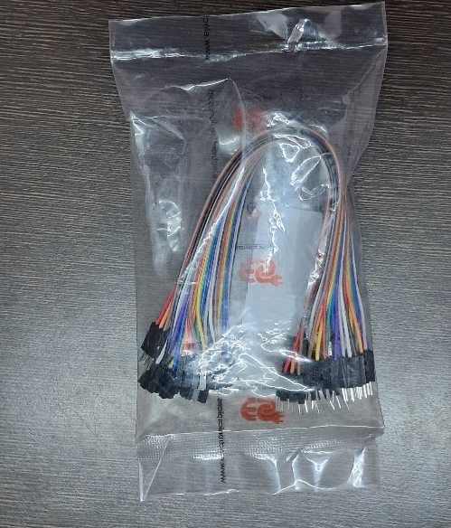
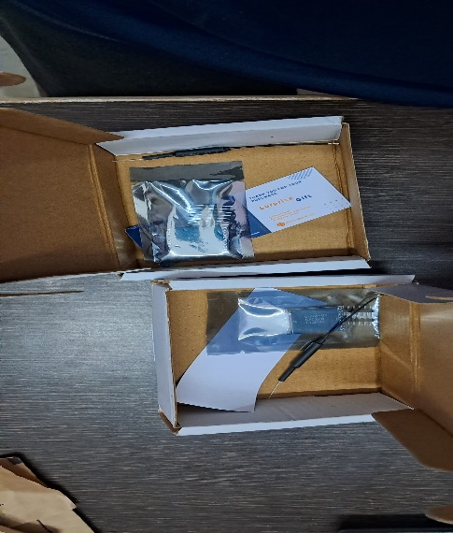
HARDWARE COMPONENTS

Slide 7
SENDER CODE
#include <SPI.h>
#include <LoRa_STM32.h>
#define SS PA4
#define RST PB0
#define DI0 PA1
#define TX_P 17
#define BAND 915E6
#define ENCRYPT 0x78
int counter = 0;
void setup()
{
Serial.begin(115200);
while (!Serial);
Serial.println("LoRa Sender");
LoRa.setTxPower(TX_P);
LoRa.setSyncWord(ENCRYPT);

Slide 8
LoRa.setPins(SS, RST, DI0);
if (!LoRa.begin(BAND))
{
Serial.println("Starting LoRa failed!");
while (1);
}
}
void loop() {
Serial.print("Sending packet: ");
Serial.println(counter);
// send packet
LoRa.beginPacket();
LoRa.print("hello ");
LoRa.print(counter);
LoRa.endPacket();
counter++;
delay(5000);
}

Slide 9
RECEIVER CODE
#include <SPI.h>
#include <LoRa_STM32.h>
#define SS PA4
#define RST PB0
#define DI0 PA1
#define TX_P 17
#define BAND 915E6
#define ENCRYPT 0x78
void setup()
{
Serial.begin(115200);
while (!Serial);
Serial.println("LoRa Receiver");
LoRa.setTxPower(TX_P);
LoRa.setSyncWord(ENCRYPT);
LoRa.setPins(SS, RST, DI0);
if (!LoRa.begin(BAND))
{

Slide 10
Serial.println("Starting LoRa failed!");
while (1);
}
}
void loop() {
// try to parse packet
int packetSize = LoRa.parsePacket();
if (packetSize) {
// received a packet
Serial.print("Received packet '");
// read packet
while (LoRa.available()) {
Serial.print((char)LoRa.read());
}
// print RSSI of packet
Serial.print("' with RSSI ");
Serial.println(LoRa.packetRssi());
}
}

Slide 11
OUTPUT
From Sender LoRa:
LoRa Sender
Sending packet: 0
Sending packet: 1
Sending packet: 2
Sending packet: 3
...

Slide 12
From Receiver LoRa:
hello 0
hello 1
hello 2
hello 3
...

Slide 13
REFERENCES
1.D. H. Kim, J. Y. Lim and J. D. Kim, "Low-Power, Long-Range, High-Data Transmission Using Wi-Fi and LoRa," 6th International Conference on IT Convergence and Security (ICITCS), Prague, Czech Republic, 2016, pp. 1-3, doi: 10.1109/ICITCS.2016.7740351.
2. U. Noreen, A. Bounceur and L. Clavier, "A study of LoRa low power and wide area network technology," International Conference on Advanced Technologies for Signal and Image Processing (ATSIP), Fez, Morocco, , pp. 1-6, doi: 10.1109/ATSIP.2017.8075570.
3. Sanchez-Iborra, R., G. Liaño, I., Simoes, C., Couñago, E., & Skarmeta, A. F. . Tracking and monitoring system based on LoRa technology for lightweight boats. Electronics, 8(1), 15.

Slide 14
THANK YOU

